Slide 1
System Identification to support Flight Test activities
22.01.2018
Alejandro Valverde

Slide 2
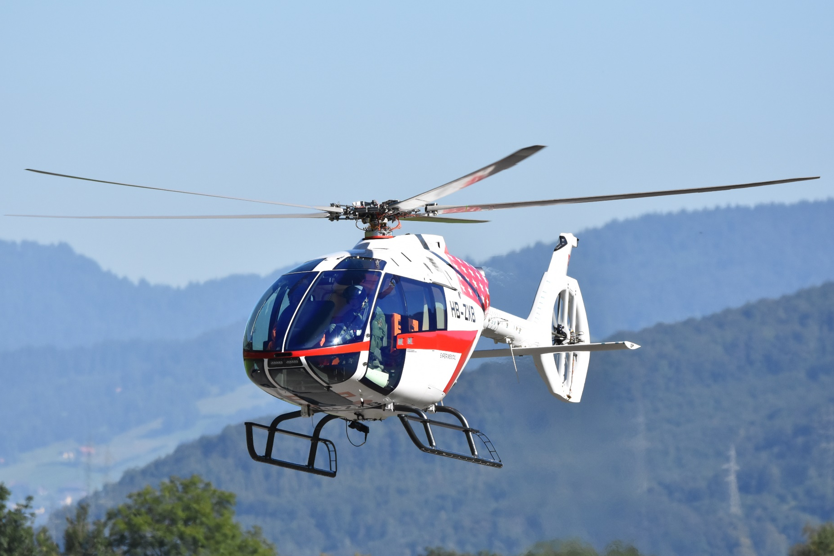
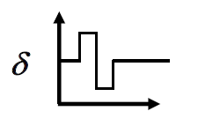
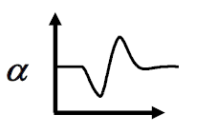
Problems in Aircraft Dynamics
Input, u
Output, z
System, S
Simulation: Given u and S, find z
Control: Given z and S, find u
Identification: Given z and u, find S
@ Kopter Group AG | Alejandro Valverde

Slide 3
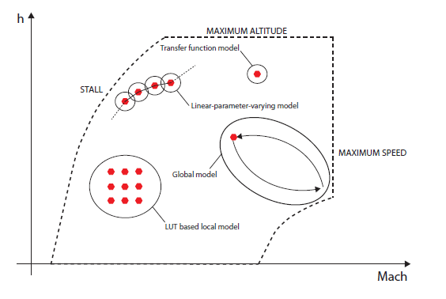
Motivations to the use System ID techniques
Verify and validate theoretical predictions for rotorcraft behaviour
Validate linearization of full helicopter dynamics from FlightLab and help development of FCS
Implement a FCS into FlightLab
Expansion of flight envelope for new aircraft
@ Kopter Group AG | Alejandro Valverde

Slide 4
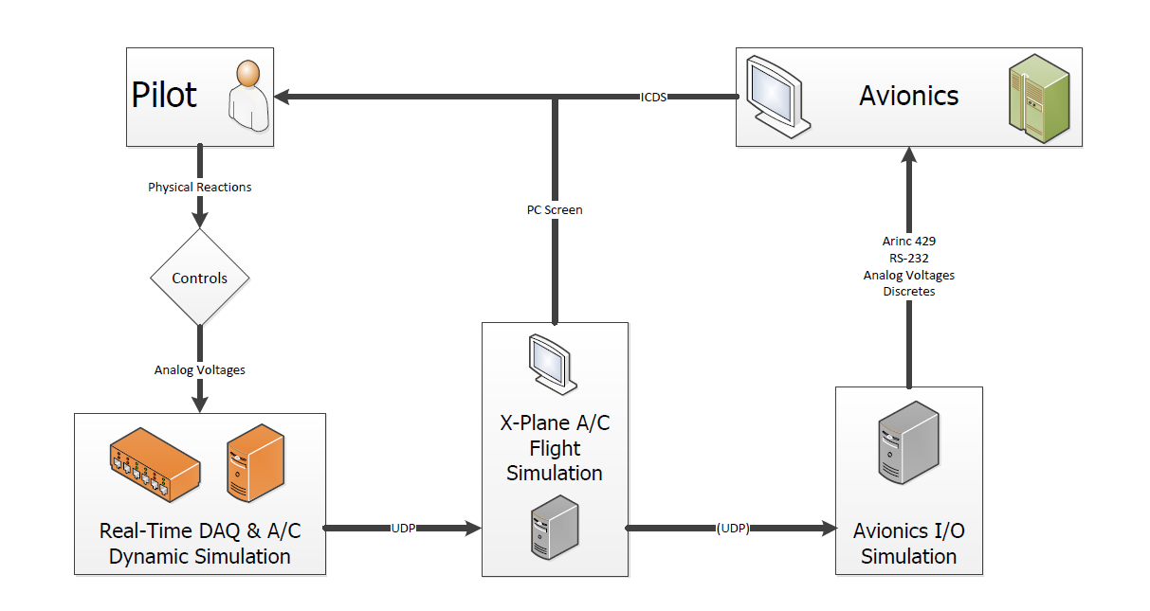

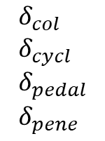
Applied to simulation
Dynamic Simulation
Extracted from Nicolas’ MSc Thesis overview in collaboration with Kopter Avionics Dep.
$$δ_{col} \\ δ_{cycl} \\ δ_{pedal} \\ δ_{pene}$$
Pilot inputs
Aerodynamic H/C model
Equations of Motion
$$X,Y,Z \\ L,M,N$$
System ID provides an accurate, simple and reliable model of the H/C dynamics obtained from real flight test data of the real H/C
LUTs
@ Kopter Group AG | Alejandro Valverde
Notes:
Accurate -> Because it’s based on real flight data
Simple -> Does not require high computational power
Reliable -> Computed with

Slide 5
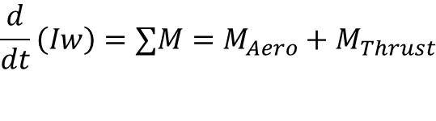
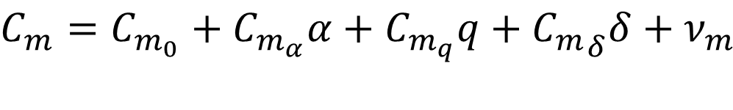
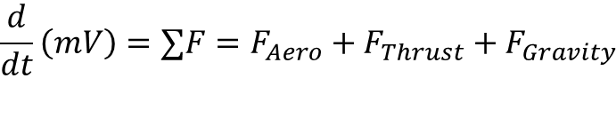
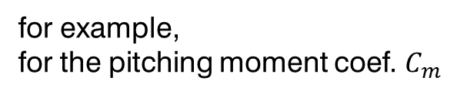


How does it work?
$$\frac{d}{dt}\left(mV\right)=∑F=F_{Aero}+F_{Thrust}+F_{Gravity}$$
Forces and moments
$$\frac{d}{dt}\left(Iw\right)=∑M=M_{Aero}+M_{Thrust}$$
$$F_{Aero}$$
Develop a model form from which parameters can be estimated using flight test data
$$M_{Aero}$$
for example,
for the pitching moment coef. $C_{m}$
longitudinal angular velocity
pitch control input
H/C angle of attack
$$C_{m}=C_{m_{0}}+C_{m_{α}}α+C_{m_{q}}q+{C_{m}}_{δ}δ+ν_{m}$$
pitching moment bias
static stability
dynamic stability (damping)
pitch control authority
@ Kopter Group AG | Alejandro Valverde

Slide 6
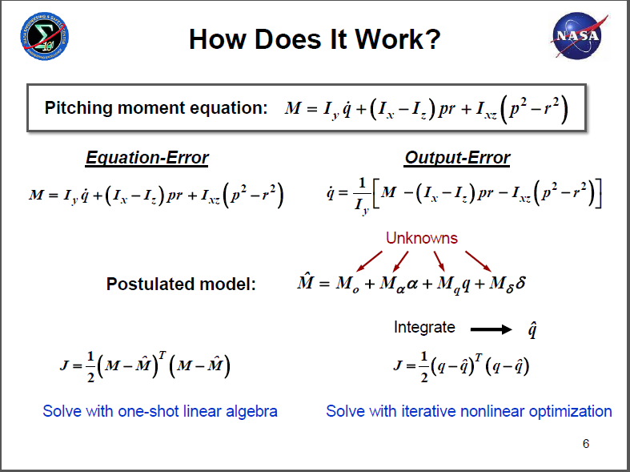
How does it work?
@ Kopter Group AG | Alejandro Valverde

Slide 7
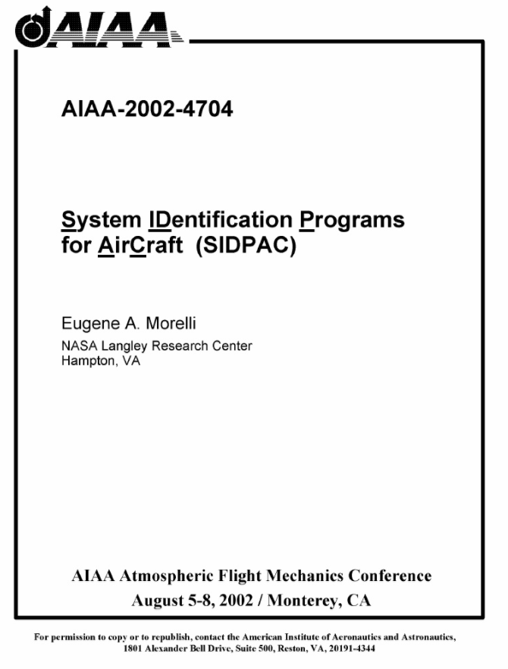
Tools
Already available
No development time needed
Proven industry suitable software
Further ways:
Python implementation
@ Kopter Group AG | Alejandro Valverde

Slide 8
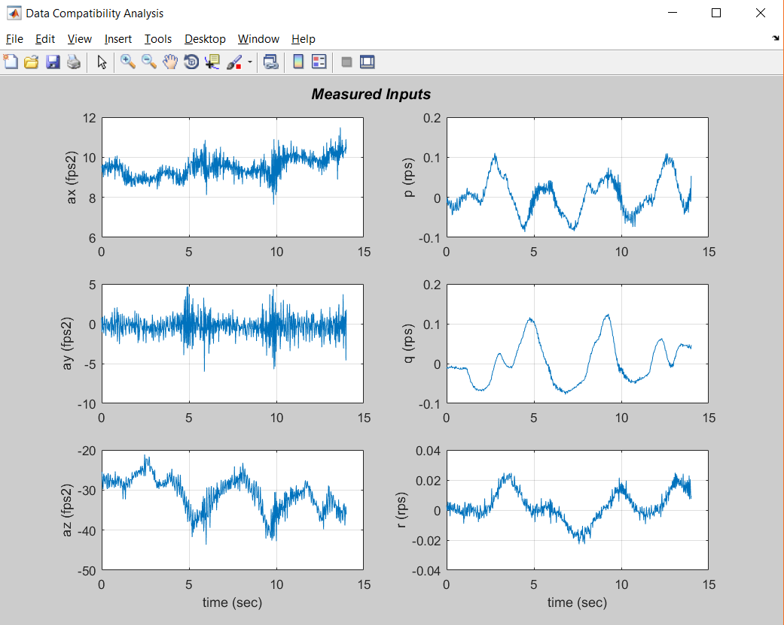
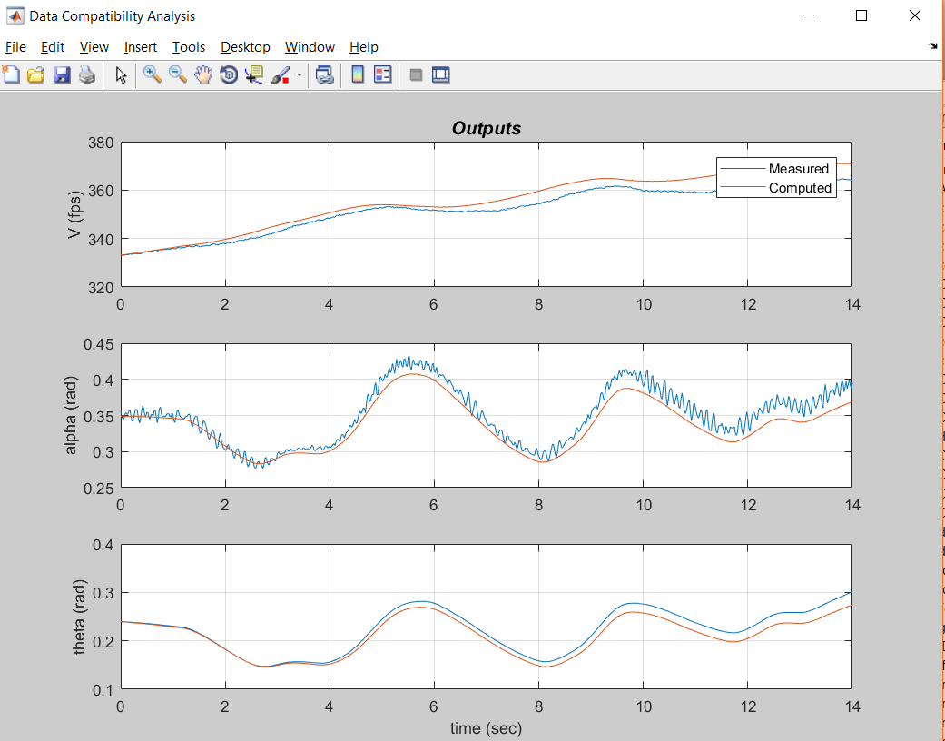

Slide 9
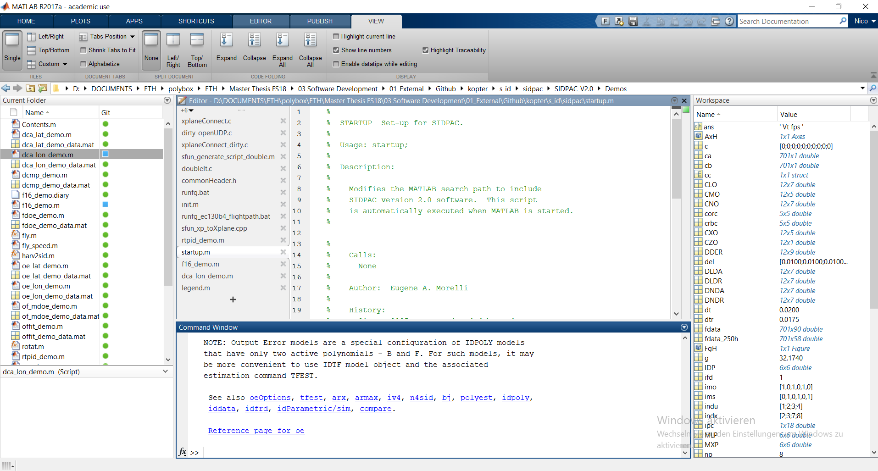

Slide 10
Why to introducing System ID into P3 test campaign?
To boost flight test productivity
Structure issues problems seem to be solved with P3, time to assess the handling qualities
Surely it will be need for PS4 and further developments after TC
Every big H/C DOA does it
System ID takes time and money – but not nearly as much as not doing it
@ Kopter Group AG | Alejandro Valverde

Slide 11
What would I need?
A laptop
some accelerometers installed in P3, a part from the usual instrumentation…
Some coffee
@ Kopter Group AG | Alejandro Valverde

Slide 12
Why I can be the one doing this?
Dilemma, won’t hide it
Inexperience industrial <-> Passion
(but yes with System ID)
Kopter experience
Data analysis experience
Python
Matlab
Data analysis and machine learning techniques
@ Kopter Group AG | Alejandro Valverde

Slide 13
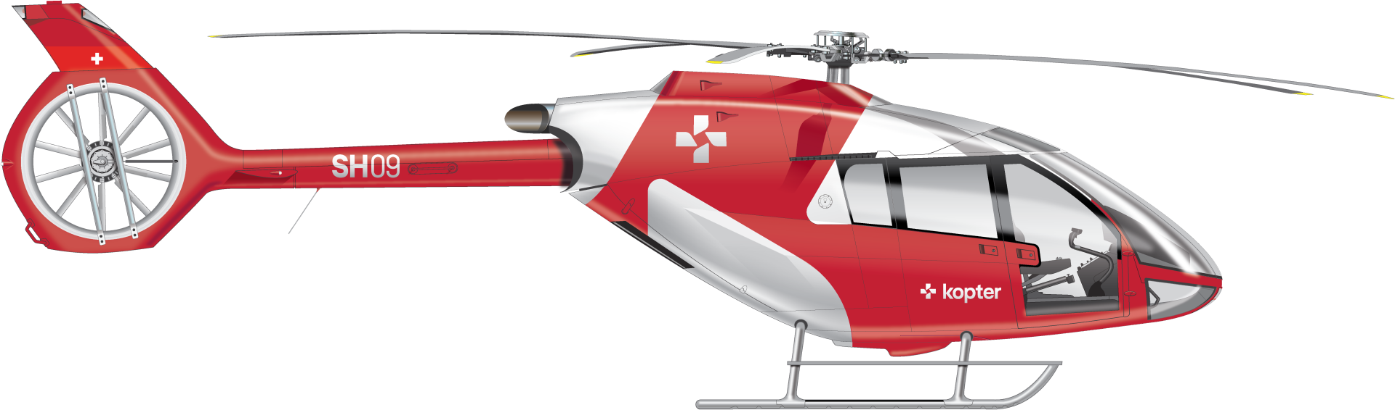
@ Kopter Group AG | Alejandro Valverde

Slide 14
Thank you

